Slide 1
Lab 07 Displaying and Fetching Information Using Dialogs and Fragments
By
M.Zakir Khan

Slide 2
A Dialog is a small window that pops up to interact with the user. It can display important messages and can even prompt for some data. Once the interaction with the dialog is over, the dialog disappears, allowing the user to continue with the application. Fragments, as the name suggests, enable us to fragment or divide our activities into encapsulated, reusable modules each with own user interface, making our application suitable to different screen sizes. That is, depending on the available screen size, we can add or remove fragments in our application.

Slide 3
Dialog ?
We usually create a new activity or screen for interacting with users, but when we want only a little information or want to display an essential message, dialog are preferred.
Dialog are also used to guide users in providing requested information, confirming certain actions, and display warning or error messages.
The following are the different dialog window types provided by the Android SDK.
Dialog … the basic class for all dialog types.
AlertDialog… A dialog with one, two or three button controls.
CharacterPickerDialog… A dialog that enable you to select an accented character associated with a regular character source.
DataPickerDialog … A dialog that enables you to set and select a date with a DatePicker control.
Progress Dialog …. A dialog that display a progressBar control showing the progress of the designated operation.
TimePackerDialog… A dialog that enable you to set and select a time with a TimePicker control.

Slide 4
Dialog Class
The following is a list of the activity class dialog methods:
showDialog()… Display a dialog and create a dialog if one does not exist. Each dialog has a special dialog identifier that is passed to this method as a parameter.
onCreateDialog()… the callback method that executes when the dialog is created for the first time. It returns the dialog of the specified type.
onPrepareDialog().. The callback method used for updating a dialog.
dismissDialog()… closes the dialog whose dialog identifier is supplied to this method. The dialog can displayed again through the shwoDialog() method.
removeDialog()… the dismissDialog() method doesn’t destroy a dialog. The dismissed dialog can be redisplayed from the cache. If we do not want to display a dialog. We can remove it from the activity dialog pool by passing its dialog identifier to the removeDialog() method.

Slide 5
Method of AlertDialog.Builder Subclass
The method of the AlertDialog.Builder subclass that we can use to configure the AlertDialog box are:
setTitle() and setIcon() … For specifying the text and icon to appear in the title bar of the dialog box.
setMessage()… For displaying a text message in the dialog box.
setPositiveButton() , setNeutralButton() and setNegativeButton()… For configuring the following three buttons:
Positive Button ----> Represent the Ok button
Negative Button ----> Represent the Cancel button
Neutral Button ----> Represent a button to transform a function other than Ok or Cancel.

Slide 6
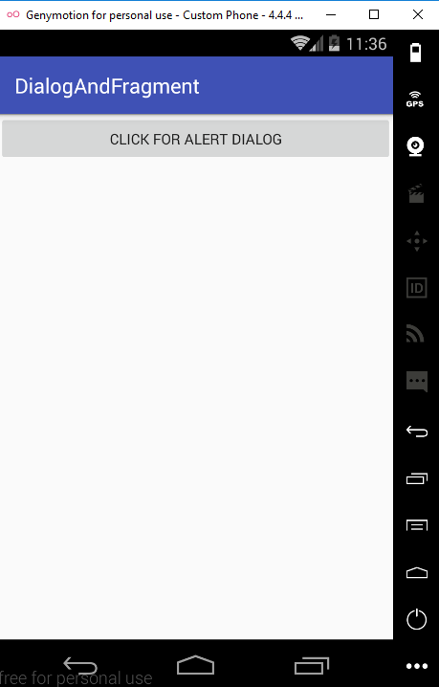
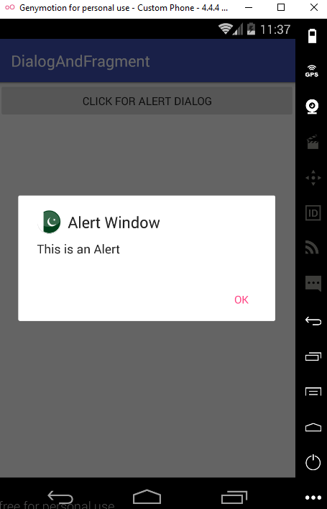
AlertDialog Layout View

Slide 7
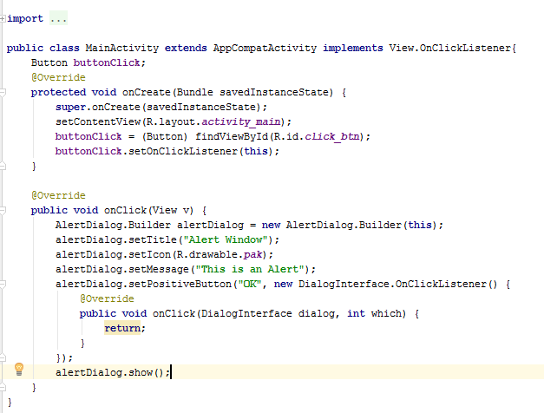
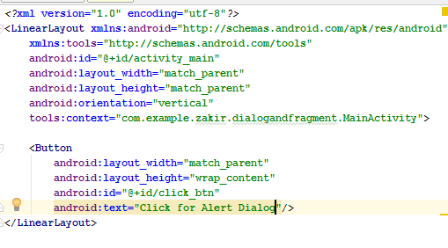
XML and JAVA code

Slide 8
Getting Input via the Dialog Box
We modify our current And roid project DialogFragmentApp to get input from the user.
We make the following changes to the application.
Dynamically create an EditText control and set it as part of the AlertDialog to prompt the user for input
Add a textView control to the layout file to display the data entered by the user in AlertDialog.

Slide 9
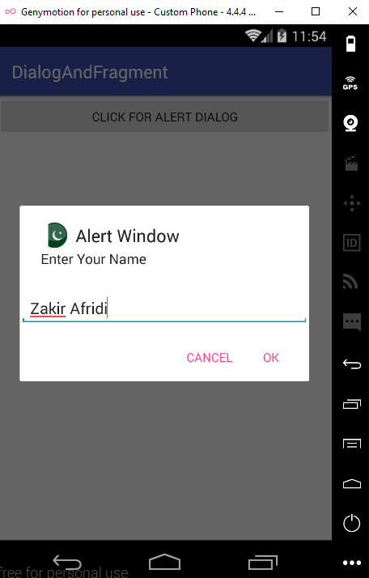
AlertDialog Layout View

Slide 10
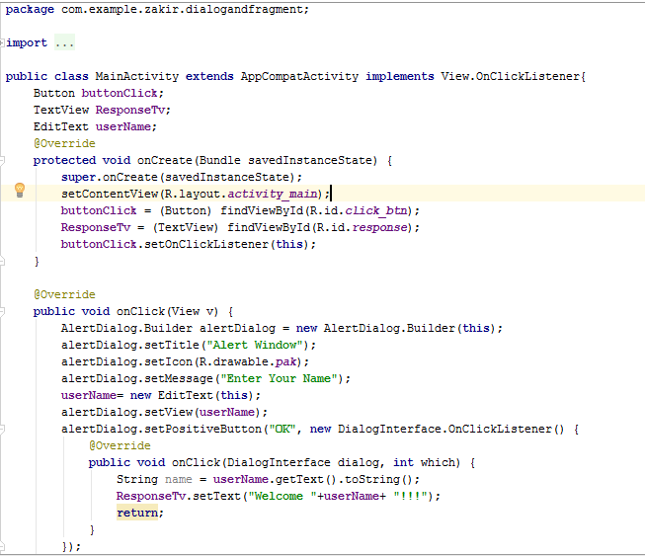
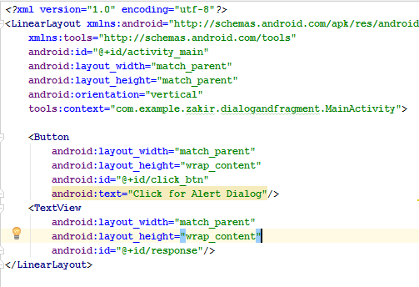
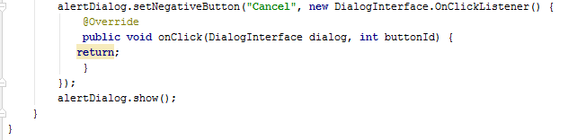
Java and Xml code

Slide 11
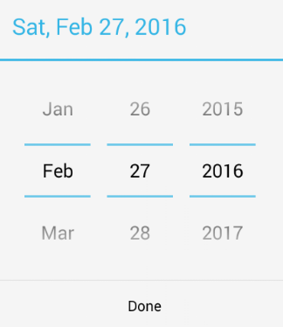
DatePickerDialog
DatapickerDialog is used to see and modify the date. We can supply the day, month and year value to its constructor to initialize the date initially display through this dialog.
The constructor includes a callback listener to inform the current context when the date has been set or changed.
To initialize the current date to the dialog, we use a calendar instance.
Note:
API level for required 24.

Slide 12
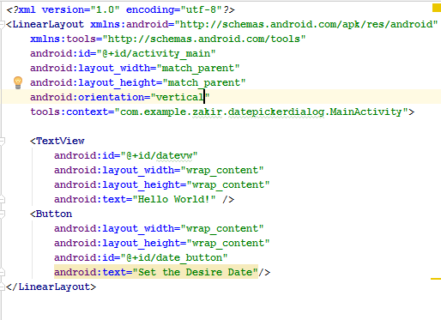
XML code

Slide 13
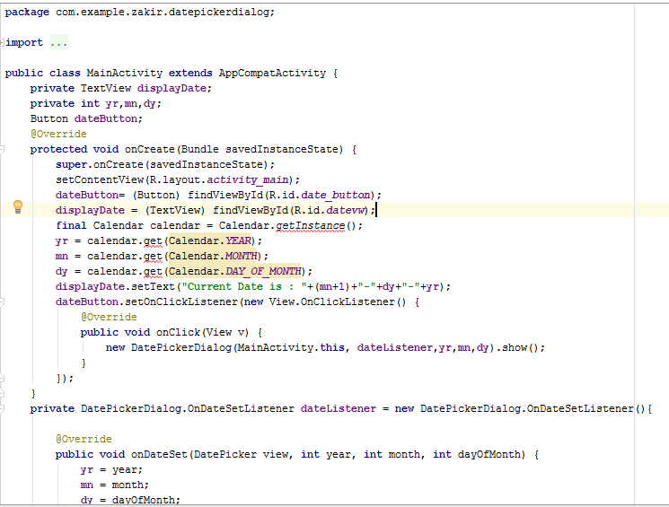
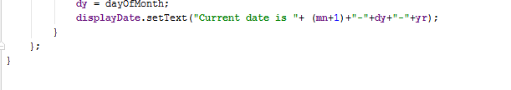
Java code

Slide 14
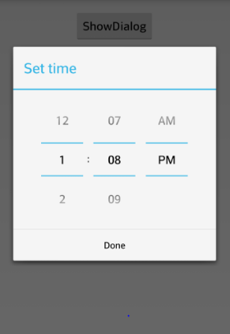
TimePickerDialog
The TimePickerDialog allow us to set or select time through the built-in Android timePicker View. We Can set the value of the hour and minute with values of hour ranging form 0 through 23 and minutes from 0 through 59.
The dialog provide a callback listener, OnTimeChangedListener or OnTimeSetListener, which tell us when a time is changed or set by the user.
Note:
API level for required 24.

Slide 15
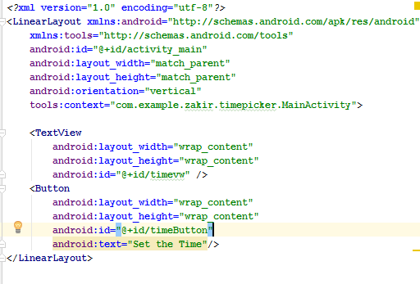
XML code

Slide 16
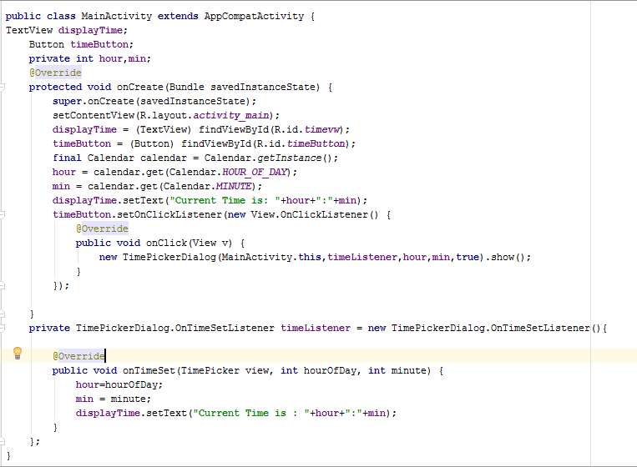
Java Code

Slide 17
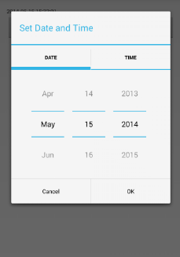
Select Date and Time in One Application
To see how the system date and time can be sent in an application.
Let’s create a new Android Application. In this application, we use a Textview and 2 buttons controls.
The textview will display the time and date of current system and the two buttons will responsible for set the date and time
Note:
API level for required 24.

Slide 18
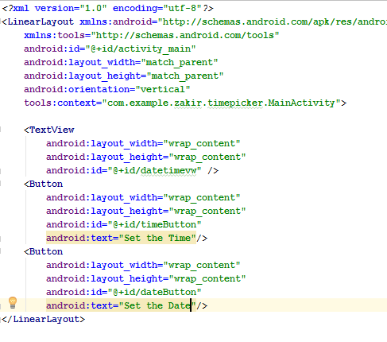
Xml code

Slide 19
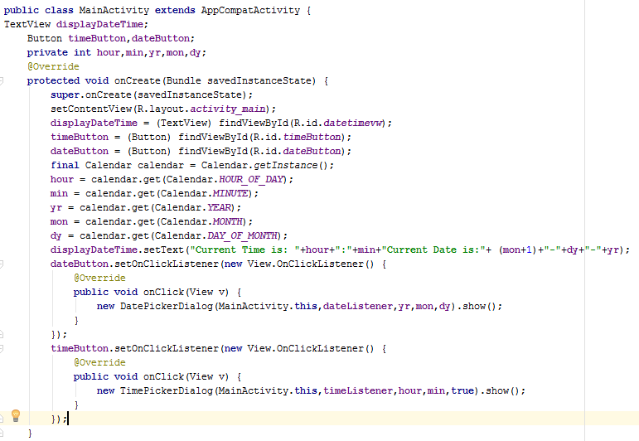
Java code

Slide 20
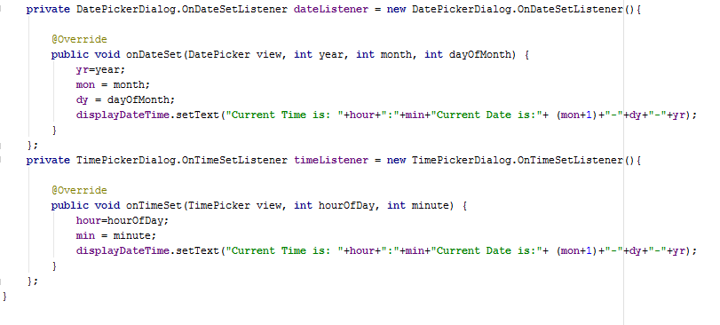
Java code continuee

Slide 21
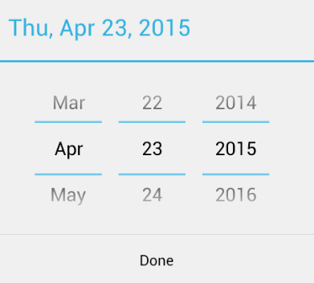
Format the date and Time
We can also format the Date and Time
I have comment the format code line which is newly included.

Slide 22
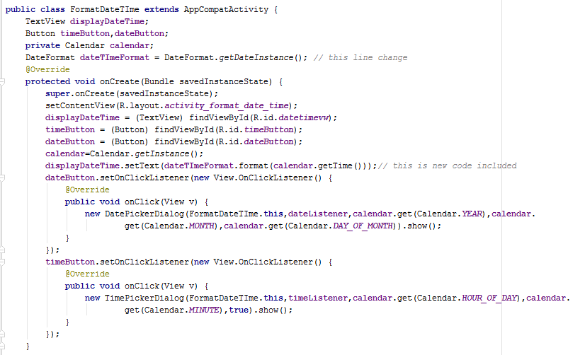
Java code

Slide 23
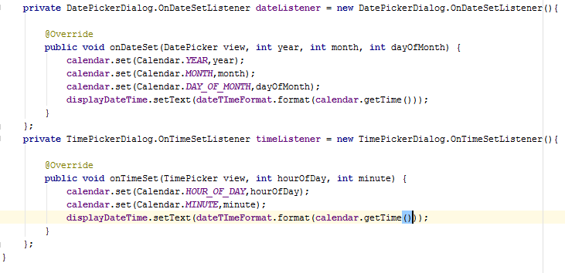
Java code continuee

Slide 24
Fragments
The size of the screen changes when a device is oriented from portrait to landscape mode. In landscape mode, the screen become wider and shows empty space on the right. The height become smaller and hides the controls on the bottom of the display.
There is a difference in screen sizes between the android phone and android tablets, as well.
Android tablets have a7-10 inch display, whereas android phones are in the range of 3-5 inches.

Slide 25
LifeCycle of Fragment
The life cycle of a fragment is affected by the activity’s life cycle in which it is embedded. That is when the activity is paused, all the fragment in it is paused. Similarly when the activity is destroyed all the fragments are destroyed as well.
onAttach() called when an activity is attached to the activity
onCreate() called when creating the fragment
onCreateView() called to create view for the fragment.
onActivityCreated()
onResume()
onPause()
onStop()
onDestroyView()
onDestroy()
onDetach()

Slide 26
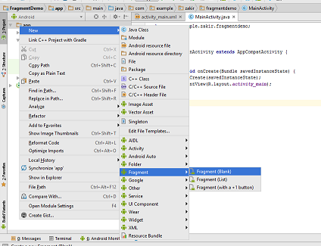
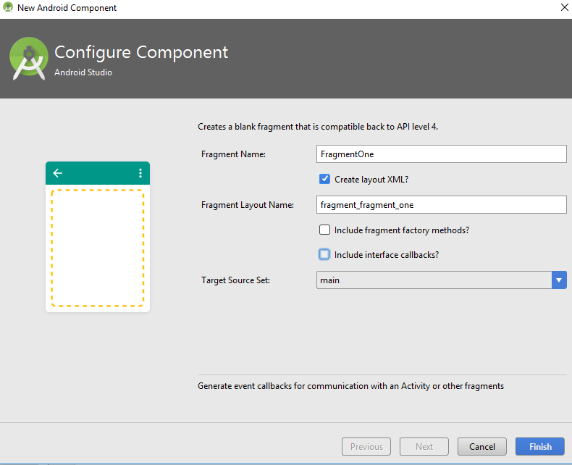
Right click on Package and select Blank Fragment as shown

Slide 27
Right click on Package and select Blank Fragment as shown

Slide 28
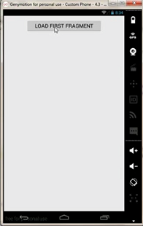
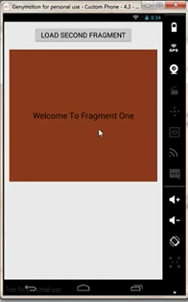
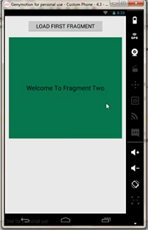

Slide 29
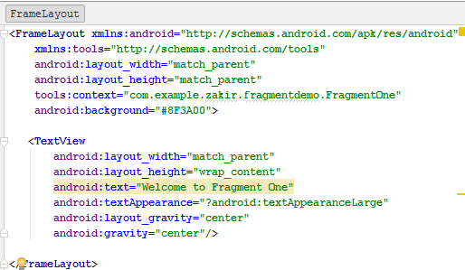
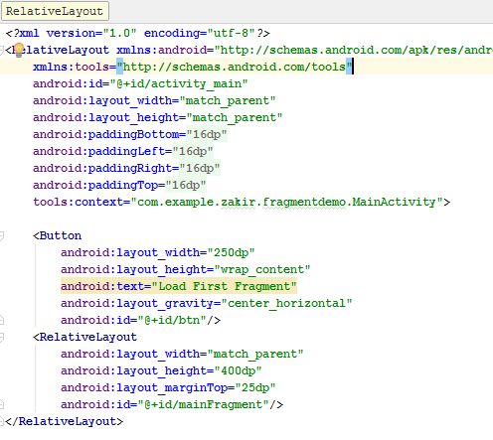
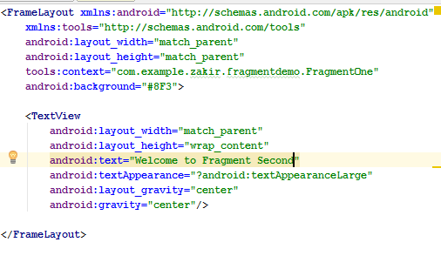
Xml Code of Fragment One and Two

Slide 30
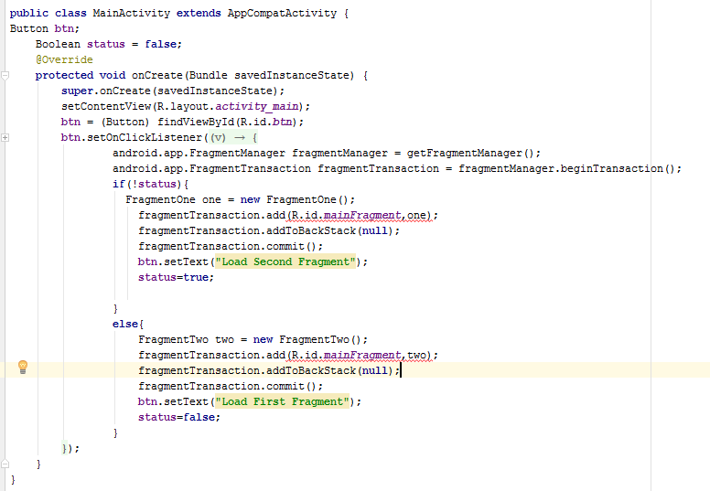
Java Code

Slide 31
SharePrefrances

Slide 32
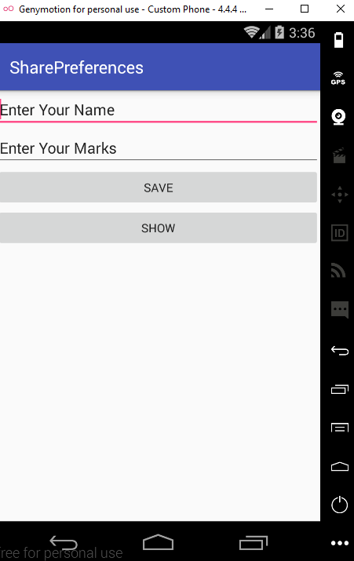
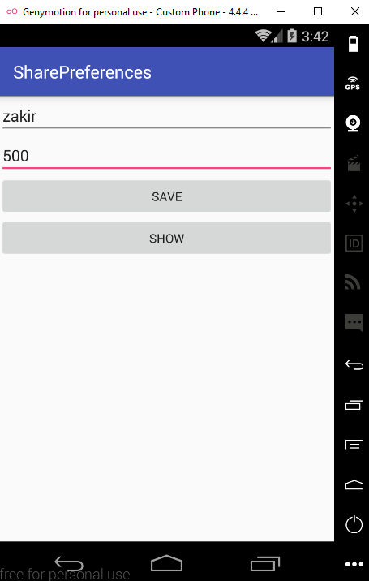
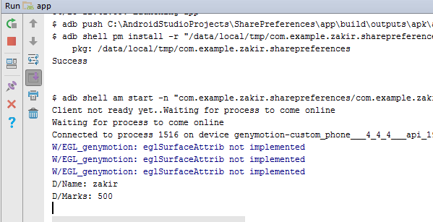
Layout File

Slide 33
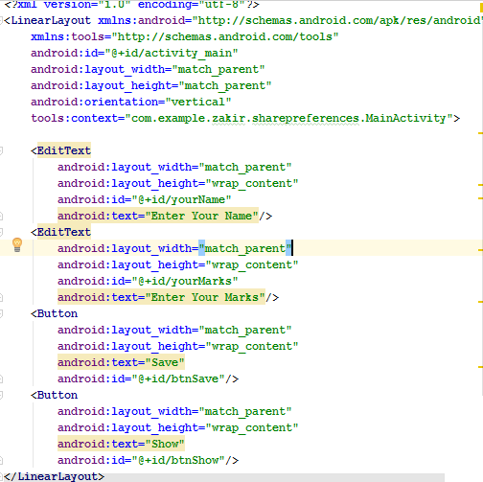
XML code

Slide 34
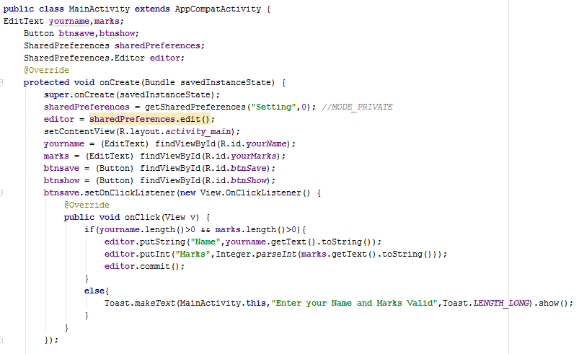
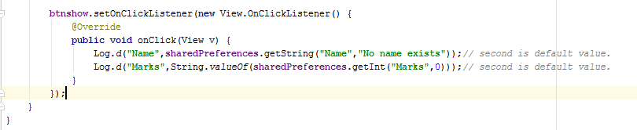
Java code

Slide 35
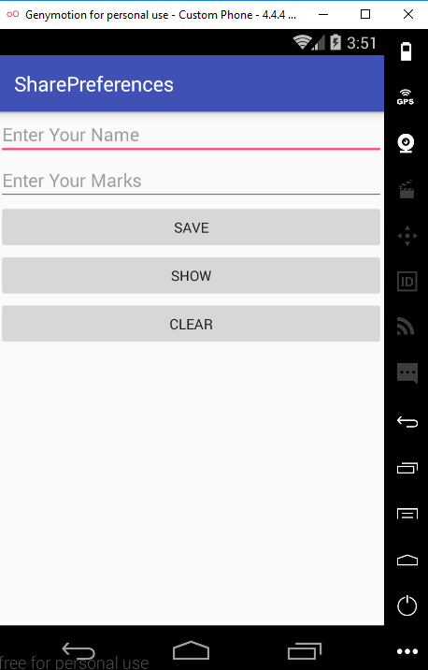
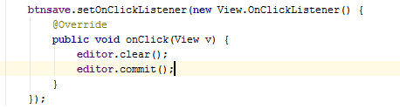
Add Clear button to Clear the Sharepreference data

